Slide 1


Meeting C++ Berlin 2017 - closing keynote
What can C++ do for embedded?
and
What can embedded do for C++?
Wouter van Ooijen MSc (ir)
Hogeschool Utrecht, Netherlands,
senior lecturer Computer Engineering
SG14 member
wouter.vanooijen@hu.nl
Notes:
Wouter van Ooijen, if too difficult Woooter will do
Backgroundf Computer Science, passion electronics and hardware/software borderland
Polytechnics
Technical Informatics, small specialization~30-50 std annually
I am NOT working in industry, I guide the next generations into inductry. I hope well prepared

Slide 2

A kevlinhenney?

Slide 3
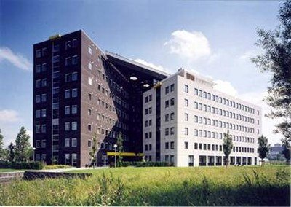
Some 20 years ago I worked for a small Dutch space company…
Notes:
Before teaching I worked in process industry, space, later defense
Small ducth company,
Everything in the Netherlands is small, except of course our ego’s

Slide 4
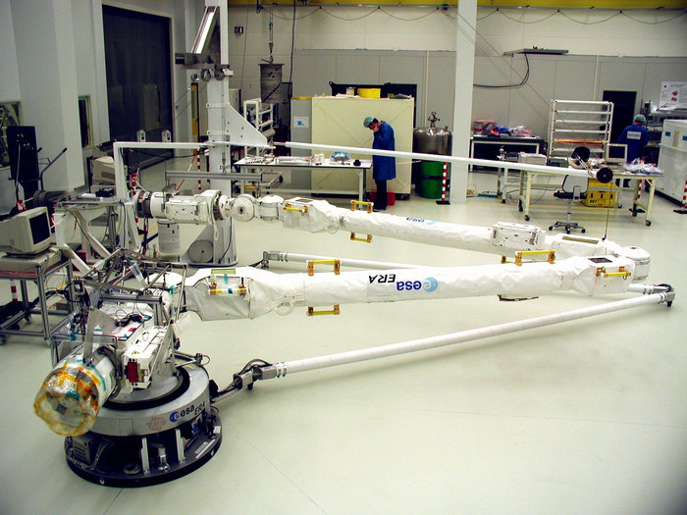
… on the the European Robotic Arm project
Notes:
To be used in the construction of the (russian segment of) the International Space Station

Slide 5
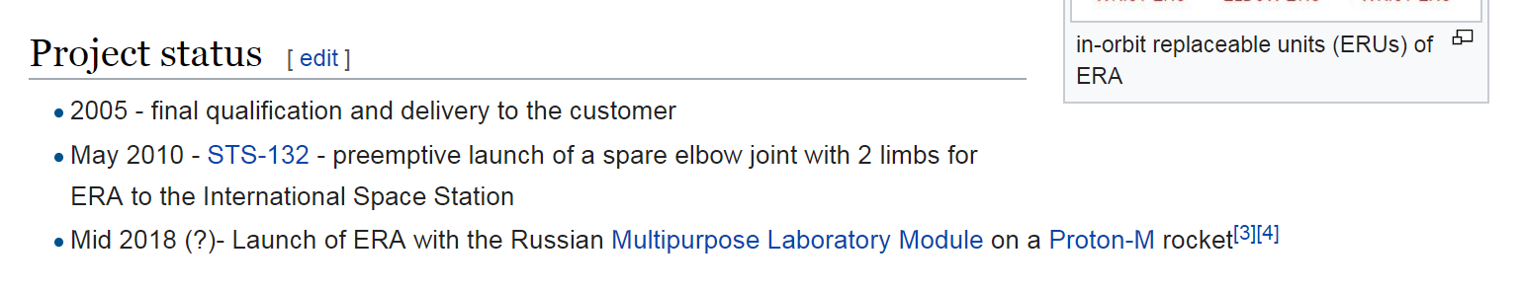
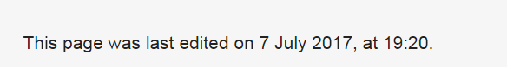
Which was delayed, delayed and delayed,
and finally mothballed for lack of a purpose.
Notes:
I kept looking an eye on the launch date
Someone obviously kept updating it ☺
Meanwhile, other projects were going on

Slide 6
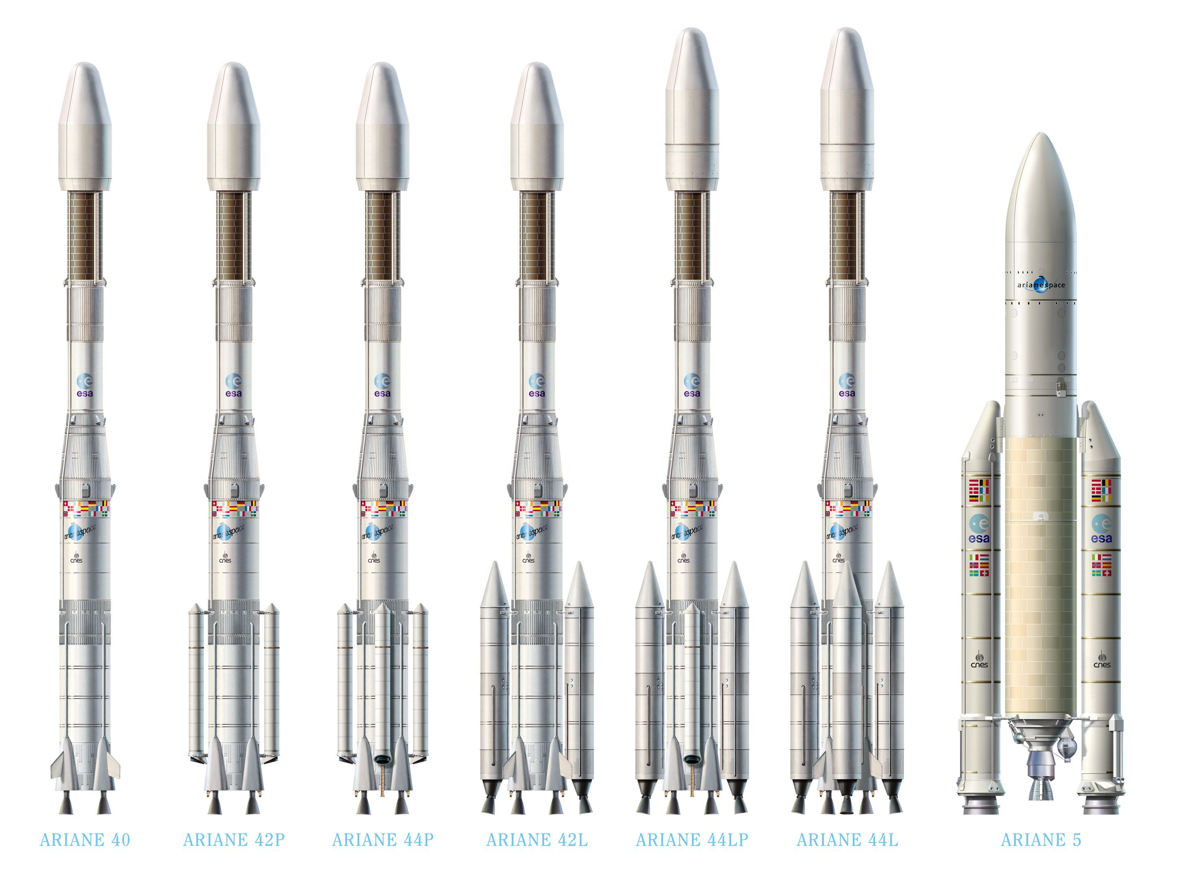
Ariane 4 ➔ Ariane 5
Notes:
You might guess what is coming, Phil Nash already mentioned it in his talk
Arianespace had designed a brand new rocket
Need for a radical new design to be commercially successfull
Fokker Space made the motor frame
First successful use ➔ last part of the payment

Slide 7
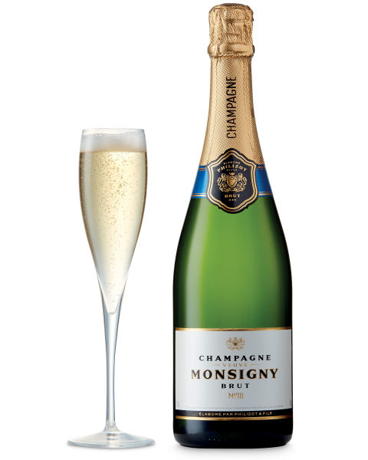
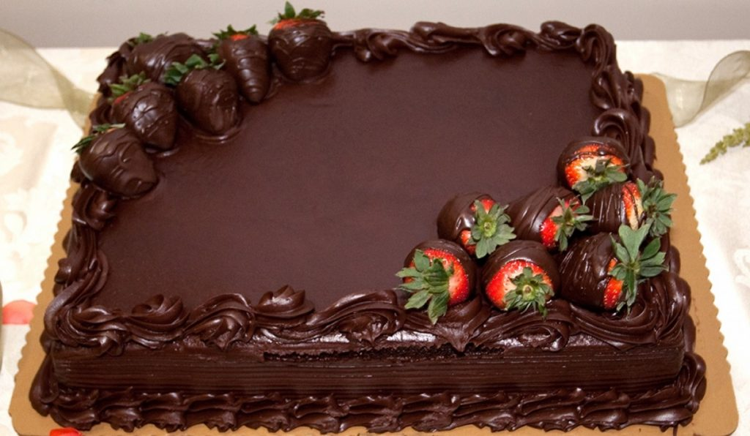
Big day
Ariane 5 maiden flight
Payment!
Notes:
I was watching from a balcony, overlooking the main hall
Down below, Champagne and cake were ready
Silence when the countdown start

Slide 8
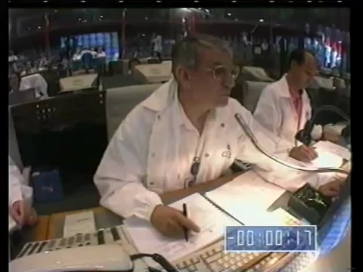
Notes:
Start film
Cheerfull chatter when the engine engnites, and we have liftoff!
@50 oops, it is not supposed to do that
Now that was an expensive firecracker!
Around E 300’000’000

Slide 9
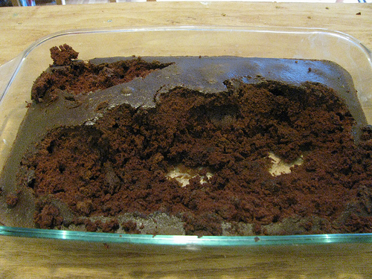
Notes:
The champagne was stowed away,
But we did eat the cake, would be a waste to let it go uneaten

Slide 10
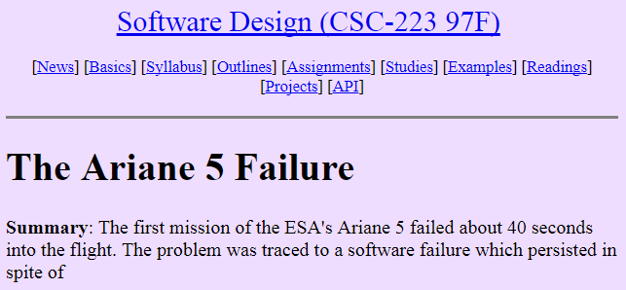
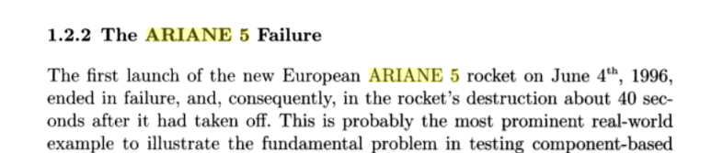
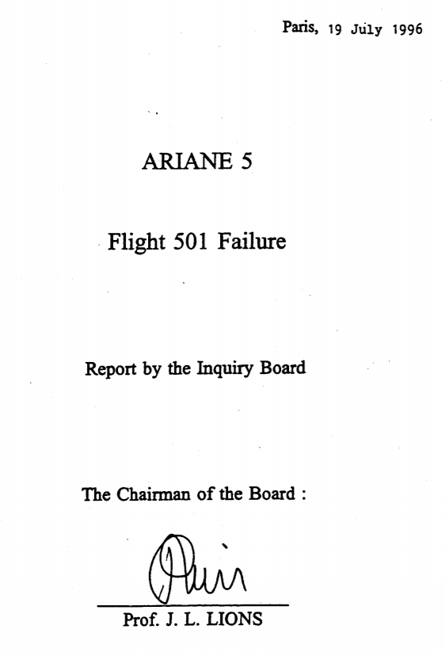
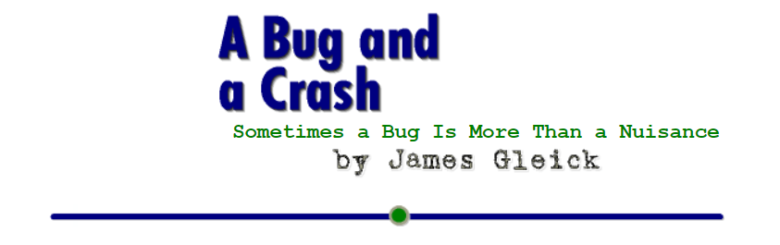
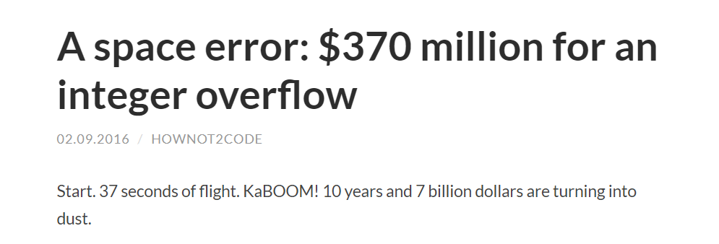
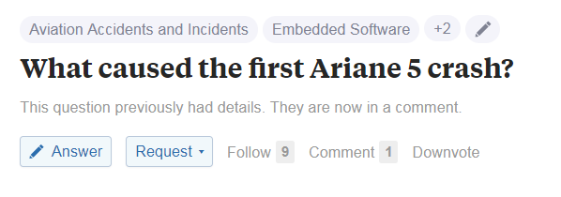
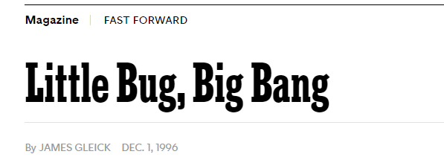
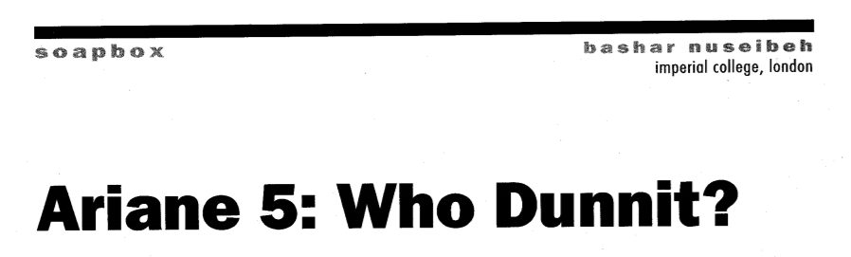
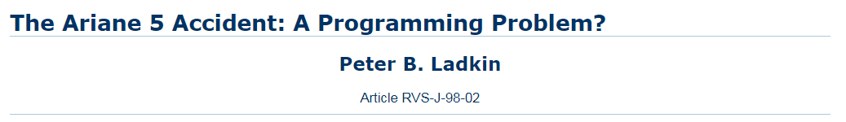
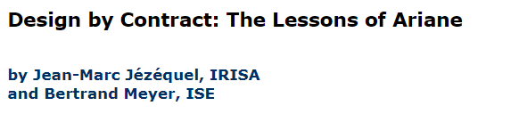
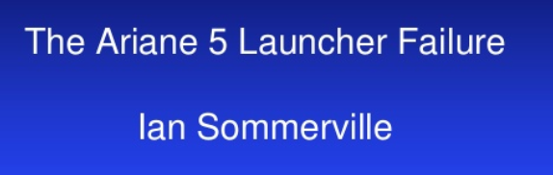
Notes:
Now what had happened?
Everyone and the dog commented, high on the list of thoroughly analysed problems

Slide 11
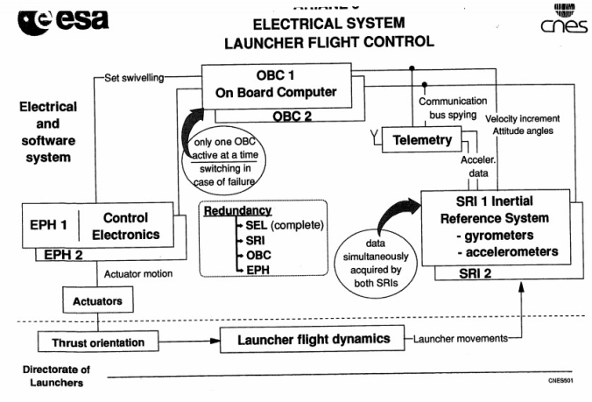
the Flight Control system
Notes:
From a distance: a simple control system:
Sensor – integration – path – difference – actuators

Slide 12
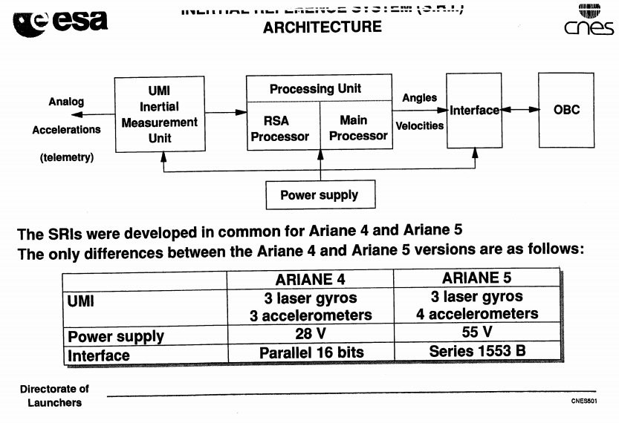
the Inertial Reference System
Notes:
Part of the flight control system
accumulates the position / orientation / velocity / aceration of the rocket

Slide 13
Design process…
Requirement: CPU load < 80%
IRS CPU load is too high
Analysis: physically HVB can’t be out of range
Agreed solution: remove the checks for HVB
Notes:
Might seem harsh, but experience is that room for last-minute additions is needed

Slide 14
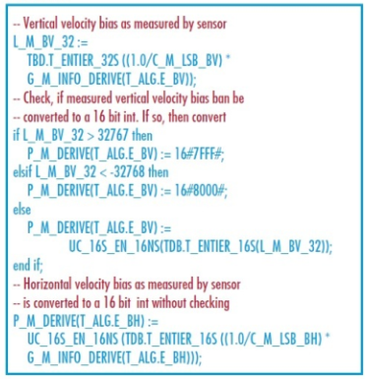
Notes:
Ada, not C++

Slide 15



Design, review, argue, test, evaluate, re-design, re-re-evaluate, re-re-re-test, re-re-re-design, re-re-re-re-re-re- ……
Design, test, execute.
Has it flown? Trust it.
Different approaches to success in space engineering
Notes:
Amercian, Russian, Frech approach

Slide 16

Chain of events
Floating-point HRS value is out of 16-bits bounds
Conversion exception occurs
Is caugth at main level, application shutdown
Switch to backup IRS fails
Diagnostic information is put on the databus
Is interpreted as flight data by the main computer
Causes extreme steering
Boosters break loose
Self-destruct engages

Slide 17
Spot the differences
Notes:
Boosters versus main engine
Liquid fuel versus solid fuel, motor versus firecracker

Slide 18
So who/what is to blame?
Task running when no longer needed
< 80 % CPU utilization requirement
Using underpowered hardware
Redundancy in HW but not in SW
Stopping all tasks when an unexpected exception occurs
Fail-totally instead of fail-gradually
Re-using Ariane 4 software in Ariane 5 (untested)
Having only ‘positive’ requirements
Using Ada
……………… add your own?
Notes:
A disaster seldom caused by a single factor, always by a chain
Where to break the chain?
Ada -> neither C/C++ nor Eifffel would have had this particular problem!

Slide 19
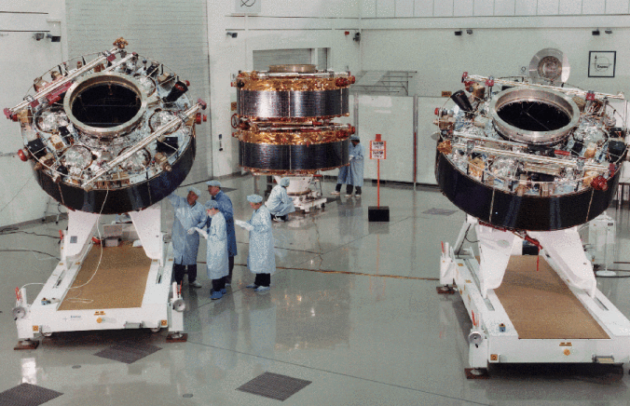
The cluster
Notes:
Magnetosphere research
‘test’ payload
No fee for launch, no insurance
Re-constructed from their spare / engineering / qualification parts
Lauched with a Russian launcher….

Slide 20

Welcome to the world of embedded
Notes:
No, not that kind of embedded
Though that can also go kabooom

Slide 21

Welcome to the embedded world – where things can go kaboom!
Notes:
But it is not all hyper-serious

Slide 22

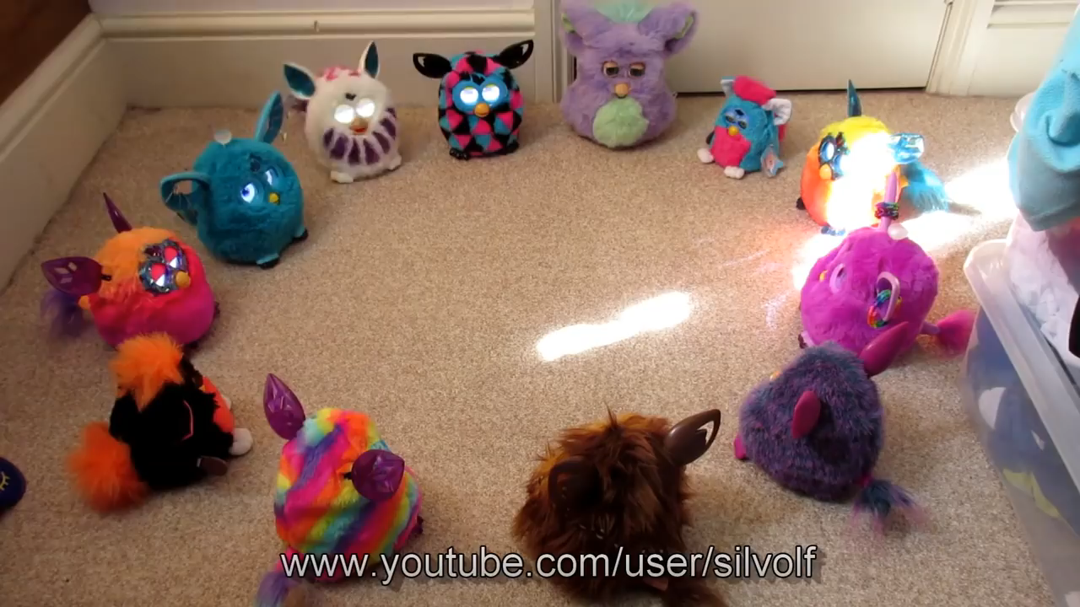
Not always that serious

Slide 23
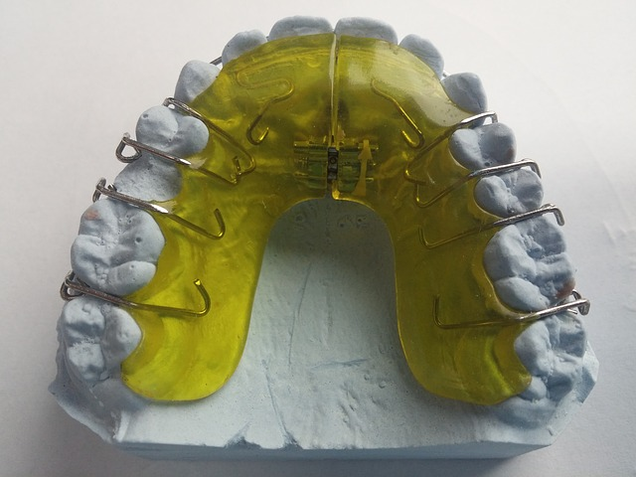
Dental brace retainer
Notes:
Take out on meals
2 sons, one takes it as a sport

Slide 24
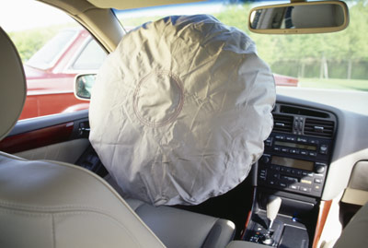
Airbag
Late might even be worse than not at all…
Notes:
Timing & reliability can be important: if it blows
to quickly
too late
not at all
at random

Slide 25
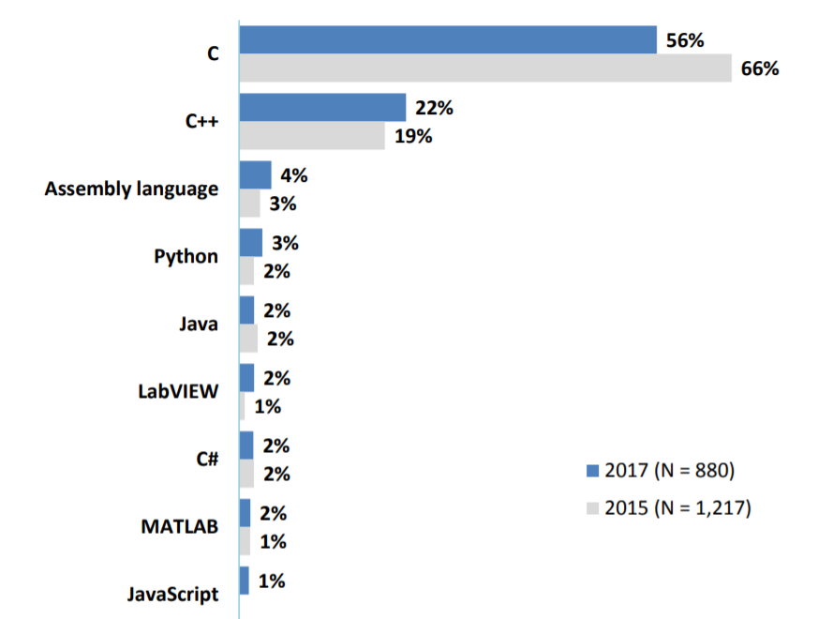
Embedded languages
AspenCore: my current embedded project is programmed mostly in…
Notes:
What are embedded systems programmed in?
Foremost C, some decent amount of C++, and a long tail of seemingly weird others

Slide 26
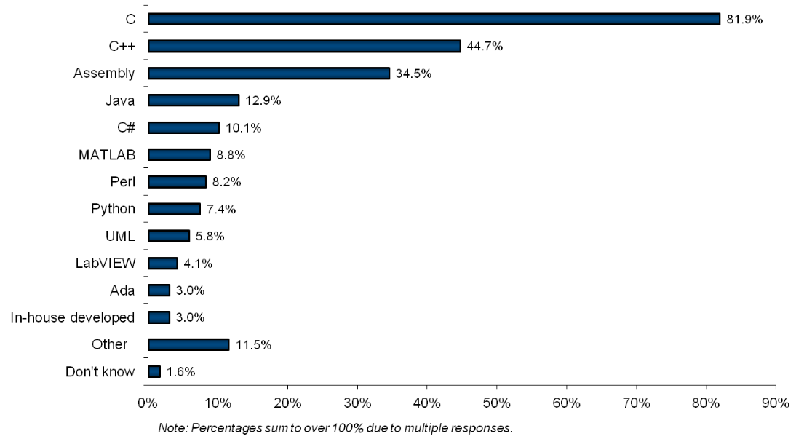
Embedded languages
2010 VDC survey
Notes:
An earlier survey showed a larger percentage of those ‘weird others’

Slide 27
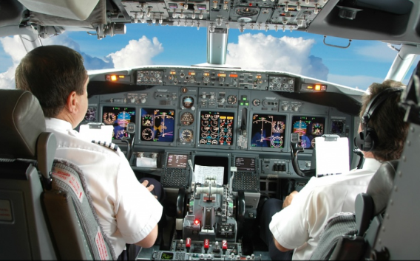

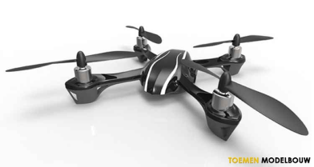

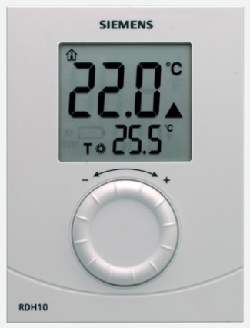
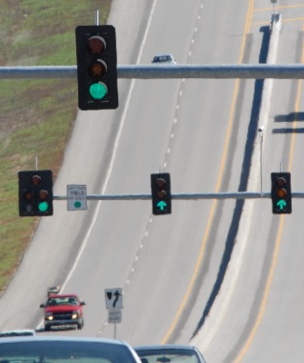
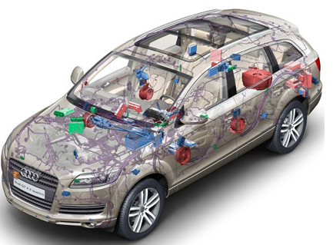
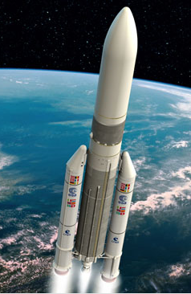

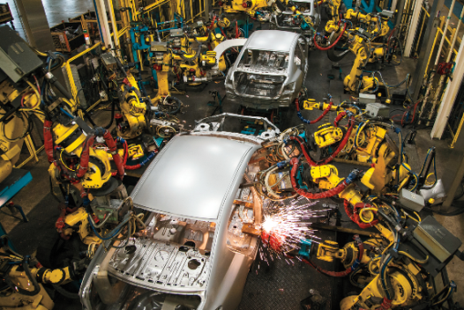
Wide span of seriousness
Notes:
Furby to nuclear power plant

Slide 28
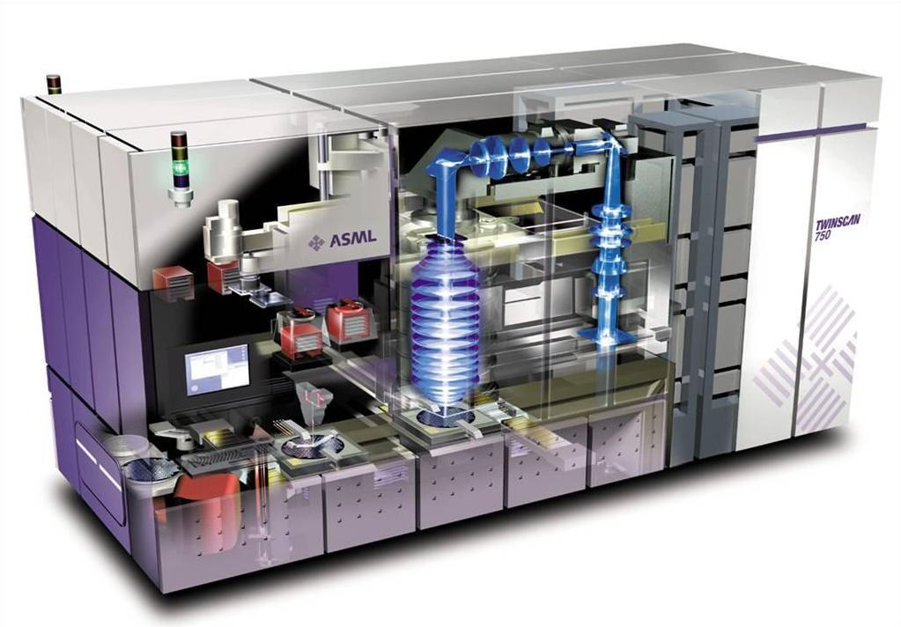
Wide span of response time
µs
ms
s
Notes:
Nuclear doesn’t require that qiock responses

Slide 29
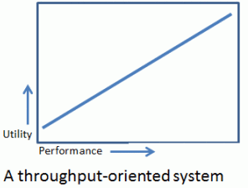
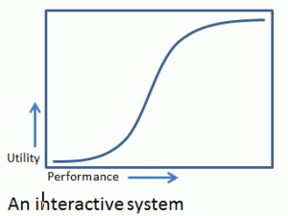
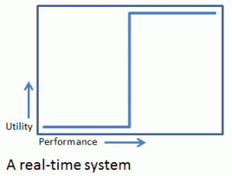
Real-time

Slide 30


Wide span of replication
1’000’000
1
100
100’000
10’000
Disclaimer: all figures are just wild guesses

Slide 31
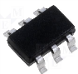
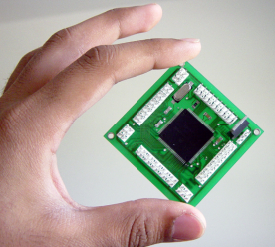
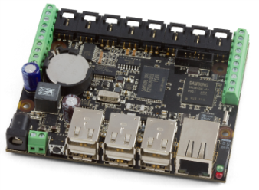
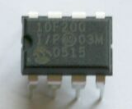
Wide span of hardware
1KiB
1MiB
1GiB
4-bit
64-bit
8-bit : 8051, PIC, AVR, …
No full standard C/C++
16-bit : MSP430, PIC, …
32-bit : ARM, MIPS, Tensilca, Intel, …

Slide 32

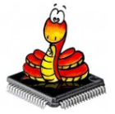


Wide span of support software
1KiB
1MiB
1GiB
Bare metal:
libraries
no separate OS
Desktop OS:
Linux
Windows
Interpreter
RTOS

Slide 33

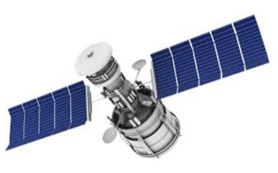
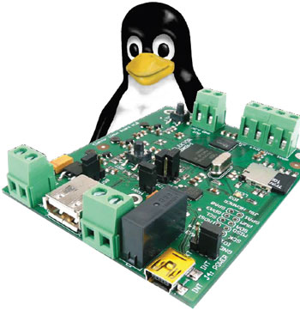
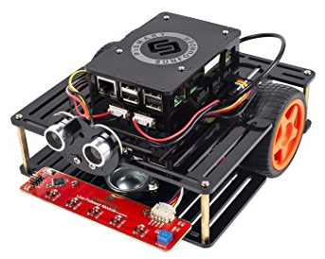

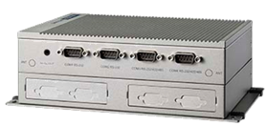
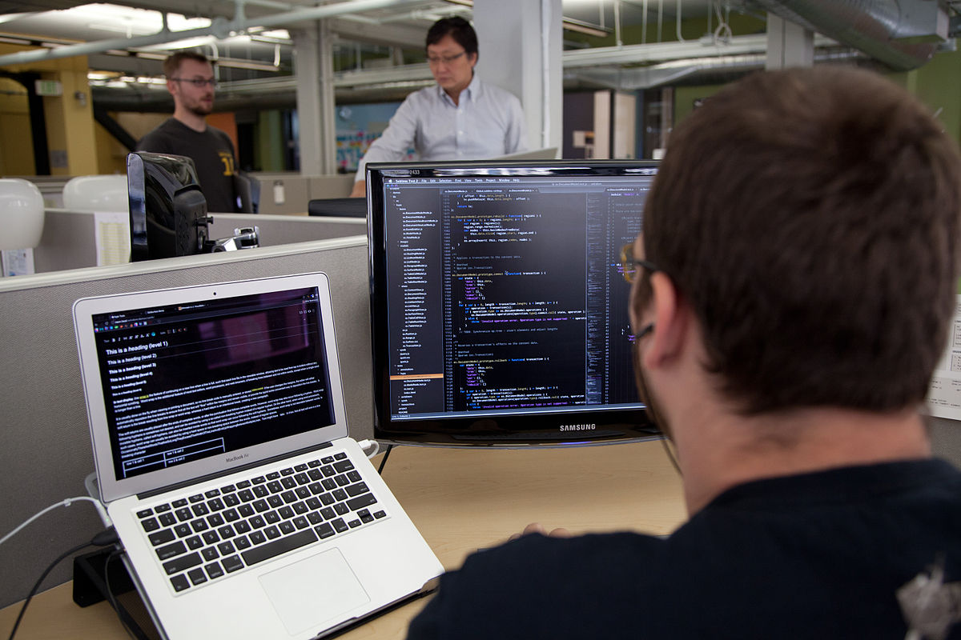


Embedded
=
Not a usable term to define
a programming style
Notes:
If you woke up now, this is my summary this far
C++ or any other programming style

Slide 34
Let’s quantify
 | 10F200 | Arduino Uno | Arduino Due | Raspberry Pi | Desktop
Code | 375 B | 32 KiB | 512 KiB | 8 GiB | 1 TiB
Data | 16 B | 2 KiB | 96 KiB | 1 GiB | 4 GiB
CPU | 8 bit | 8 bit | 32 bit | 32 bit | 64 bit
Clock | 4 MHz | 16 MHz | 84 MHz | 900 MHz | 3 GHz

Slide 35
Real numbers
1KiB
1MiB
1GiB
 | 10F200 | Arduino Uno | Arduino Due | Raspberry Pi | Desktop
Code | 375 | 32768 | 524288 | 8589934592 | 1099511627776
Data | 16 | 2048 | 98304 | 1073741824 | 4294967296
CPU | 1000000 | 16000000 | 168000000 | 3600000000 | 30000000000
Notes:
Approximations:
comparing 10F200 and Arduino MHz is unfair => put 10F at 1 MHz
I counted 32 bits as * 2, floating point as * 4, fp + multi-core as * 10

Slide 36
Relative
 | 10F200 | Arduino Uno | Arduino Due | Raspberry Pi | Desktop
Code | 1 | 87 | 1398 | 22906492 | 2932031007
Data | 1 | 128 | 6144 | 67108864 | 268435456
CPU | 1 | 16 | 128 | 3600 | 30000
Notes:
That does get rid of some of those digits, but there are still too many

Slide 37
Log
 | 10F200 | Arduino Uno | Arduino Due | Raspberry Pi | Desktop
Code | 0.000000 | 4.470282 | 7.242870 | 16.946931 | 21.798961
Data | 0.000000 | 4.852030 | 8.723231 | 18.021827 | 19.408121
CPU | 0.000000 | 2.772588 | 5.1239639 | 8.1886891 | 10.3089526

Slide 38
Rounded log
 | 10F200 | Arduino Uno | Arduino Due | Raspberry Pi | Desktop
Code | 0 | 4 | 7 | 17 | 22
Data | 0 | 5 | 9 | 18 | 19
CPU | 0 | 3 | 5 | 8 | 10
Notes:
That is better, but it still doesn’t easily show the differences
And those numbers lack a proper unit, so let’s add units

Slide 39

Unit of (log) size?

Slide 40



Unit of (log) speed?

Slide 41
Relative, with ‘units’
 | 10F200 | Arduino Uno | Arduino Due | Raspberry Pi | Desktop
code Moore | 0 | +4 | +3 | +10 | +5
data Moore | 0 | +5 | +4 | +9 | +1
Hopper | 0 | +3 | +2 | +3 | +2

Slide 42
No alternative
 | 10F200 | Arduino Uno | Arduino Due | Raspberry Pi | Desktop
code Moore | 0 | +4 | +3 | +10 | +5
data Moore | 0 | +5 | +4 | +9 | +1
Assembler
I am actually doing electronics diguised as code.
Maybe I’ll consider C
Notes:
Compilers? 3-p libraries? RTOS?? You’ve got to be kidding
I’ll fill all those 256 instructions myself!
But there are easier ways to write those instructions!

Slide 43
You can afford
RTOS
GP OS
 | 10F200 | Arduino Uno | Arduino Due | Raspberry Pi | Desktop
code Moore | 0 | +4 | +3 | +10 | +5
data Moore | 0 | +5 | +4 | +9 | +1
Interpreter
Notes:
At least size-wise
Historic interpreters could be much smaller, a few KiB for an integer-only basic
but those are no match for current compiling development environments

Slide 44
Where does C++ fit in?
Assembler
Interpreter
RTOS
GP OS
 | 10F200 | Arduino Uno | Arduino Due | Raspberry Pi | Desktop
code Moore | 0 | +4 | +3 | +10 | +5
data Moore | 0 | +5 | +4 | +9 | +1
Hopper | 0 | +3 | +2 | +3 | +2
If you need performance …

Slide 45

Otherwise
Notes:
At least size-wise
Historic interpreters could be much smaller, a few KiB for an integer-only basic
but those are no match for current compiling development environments

Slide 46



Notes:
At least size-wise
Historic interpreters could be much smaller, a few KiB for an integer-only basic
but those are no match for current compiling development environments

Slide 47




C++ versus Python
Actually compiled versus interpreted
 | Penalty
Size | 0.3 .. 1.3 Moore
Speed | 0.3 .. 2.3 Hopper

Slide 48
C++ versus Python
Actually compiled versus interpreted
 | Penalty
Size | 0.3 .. 1.3 Moore | 2 .. 20
Speed | 0.3 .. 2.3 Hopper | 2 .. 200

Slide 49
Where does C++ fit in?
Assembler
Interpreter
RTOS
GP OS
 | 10F200 | Arduino Uno | Arduino Due | Raspberry Pi | Desktop
code Moore | 0 | +4 | +3 | +10 | +5
data Moore | 0 | +5 | +4 | +9 | +1
Hopper | 0 | +3 | +2 | +3 | +2
small-embedded C++ alley

Slide 50
Size & speed margin
Very low margin:
Use Assembler
Comfortable margin:
Consider using an interpreter
Moore | 0 | +1 | +2
Hopper | 0 | +1 | +2
small-embedded C++ alley
Notes:
Left:
Or use other (less risky) hardware
Right:
Especially if you have changing user requirements, low volume
Size factor 2 .. 20
Speed factor 2 .. 200

Slide 51
embedded

Slide 52
fast trading
gaming
MiB, GiB
GHz, multi-core
Memory latency, caches
simulation
large-embedded
bytes, KiB
MHz, Interrupts
Hardware peripherals
Battery life-time
small-embedded

Slide 53
fast trading
gaming
simulation
SG14:
low-latency
large-embedded
small-embedded

Slide 54

What does C++ do for small-embedded?

Slide 55

What does C++ do for embedded?
ADTs: abstraction, data hiding, type-checking, enum class
Overloading, operators
Namespaces
Argument defaults, references
Const, constexpr
}, RAII
Templates
DSLs (using templates, operators, overloading)
Notes:
Compared to C!
Perventing errors
Code organization

Slide 56
ADTs: abstraction, data hiding, type-checking
Overloading, operators
Namespaces
Argument defaults, references
Const, constexpr
}, RAII
Templates
DSLs (using templates, operators, overloading)
Note that most:
Are zero cost
Were NOT included for embedded
Help to reduce MACRO’S
Notes:
Reduce those attention-wasting SHOUTING macros
(who still write their constants and enum values in CAPITALS??)
➔ That means that it facilitates things that even (right-minded) C programmers want!

Slide 57
Less usefull?
Exceptions : (small-) embedded is often ‘mission-critical’
Heap : idem
OO : not free
User-defined literals : not easy to combine libraries
Bit-fields : not enough control, and can be done adequately (and encapsulated!) with other means
Notes:
Compared to C

Slide 58
Annoying
All (library) assumptions that are hard-coded
Extra space is allocated on the heap
Integer calculations are done using int
Floating-point calculations are done using double
Special situations are reported by exceptions
This function must be fast / small
Caching determines speed, so avoid linked lists
All that matters is amortized complexity
Notes:
Compared to C
In a sense these are all singeltons: things the library grabs without your consent and there is nothing you can do

Slide 59

Heap
The heap is flexibility with respect to the amount of data, at the cost of (some) unpredictability in run-time and maximum available memory (fragmentation).
A typical small embedded system
has a rigidly prescribed task, including the size of the data involved
Must meet real-time constraints
Should be certain to meet work OK all the time (not just for a certain sequence of actions).
A heap and a small embedded system don’t match very well. Better:
Global allocation (!)
Fixed size pools or fixed size containers

Slide 60

Exceptions
Exceptions are great to handle a local problem that requires a (more) global response.
A small system often has a rather simple, rigidly defined task
there are no exceptions, only different situations.
No heap ➔ one reason less to use exceptions.
Exception implementation often uses the heap….
Straw man: exceptions are slow and have unpredictable timing.

Slide 61

Floating point
FP is useful when a wide dynamic range is needed. For an embedded application the ranges are often very well known. (but… Ariane 5?)
Small micro-controllers often don’t have a hardware FPU. A software FP library
Is considerably slower
Takes up ROM
Make your software ‘open’:
template< typename value_type = double >
class your_amazing_library {
. . .

Slide 62
”Just” print
struct location { int x, y; };
void print_location( FILE * f, location v ){
fprintf( f, "(%d,%d)", v.x, v.y );
}
std::ostream & operator<<( std::ostream & out, const location & v ){
return out << '(' << v.x << ',' << v.y << ')';
}
template< typename OUT >
auto operator<<( OUT & out, const location & v )
-> decltype( out << 'x' ) &
{
return out << '(' << v.x << ',' << v.y << ')';
}
Notes:
Someone remarked yesterdag: the word “just” is a documentation smell
The C++ versiion scores low on diversity – it excludes me and my small chips

Slide 63
Why don’t they all use C++?
No compiler available (PIC, 8051)
Not allowed
Existing code base
It is too complex
The style is inappropriate
Code bloat
Notes:
Domain experts, proud!, programming is only part of their job, too old to learn new ways
3 unavoidable
3 can be solved (1 is nonsense)

Slide 64


(The) hard-embedded programming example:
for(;;){
led.set( true );
wait();
led.set( false );
wait();
};
Let’s blink a LED!
Notes:
This is the embedded equivalent of “Hello world”

Slide 65

Take the blue pill
Notes:
In other contexts I might take the red one
Let’s take a blue pill, so some ugly details remain hidden from us

Slide 66



STM32Duino ”Blue pill”
STM32F103C8T6, Cortex-M3 32 bit CPU, 72 MHz
64 Kbyte FLASH (code & contants memory)
20 Kbyte RAM
32 I/O pins (chip has max 37)
< E 2.00 (aliexpress)
Notes:
Hardware-wise this feels like cheating, but your are not here for EE
Very cheap
Some doubt about quality
Also red pill, black pill

Slide 67


Memory map
GPIO registers
Notes:
For micro-controllers 32 bit of address space is still a LOT
Nearly all CPUs used memory-mapped peripherals
Registers here means memory-mapped hardware interfaces

Slide 68

How to make a pin high or low
Notes:
This part of one of the 1133 pages of the reference manual
One of the more readable ones!
Alternatuive is read-modify-write: slower, and concurrency problem

Slide 69
In C - directly
// blink the on-board LED at PORTC, pin 13
#include "stm32f103x6.h"
void wait();
int main( void ){
// enable the PORTC peripheral clock
RCC->APB2ENR |= RCC_APB2ENR_IOPCEN;
// make the pin an output
GPIOC->CRH &= ~( 0x0F << 20 ); // CRH if pin > 7
GPIOC->CRH |= ( 0x03 << 20 ); // 20 = 4 * ( 13 % 8 )
for(;;){
GPIOC->BSRR |= ( 0x01 << 13 ); // 1 << 13 for reset
wait();
GPIOC->BSRR |= ( 0x01 << 29 ); // 1 << ( 13 + 16 ) for set
wait();
};
}
Notes:
This is the embedded equivalent of “Hello world”

Slide 70
In C - directly
for(;;){
GPIOC->BSRR = ( 0x01 << 13 );
wait();
GPIOC->BSRR = ( 0x01 << 29 );
wait();
};
mov r6, #8192
mov r5, #536870912
ldr r4, .L3+4
. . .
.L2:
str r6, [r4, #16]
bl _Z4waitv
str r5, [r4, #16]
bl _Z4waitv
b .L2
. . .
.L3:
.word 1073876992
.word 1073811456
Instructions | Direct
Call | 1*
Library | -
gcc 6.2.0, -mcpu=cortex-m3 -Os -std=c11
http://www.github.com/wovo/2017-berlin
Notes:
This is the embedded equivalent of “Hello world”
We all heared “less assembly is better”?
I want to be a bad guy, so I include some assembler ☺

Slide 71


github

Slide 72
push:
make clean
git add -A
git commit -a -m "update"
git push
Notes:
A little bit better: use a macro

Slide 73

git add -A
git commit -a -m "update"
git push
pause
Notes:
A little bit better: use a macro

Slide 74

_push.bat
_pull.bat
Notes:
A little bit better: use a macro

Slide 75
In C – use a macro
// set the pin port.pin to value
#define PIN_SET( port, pin, value ) . . .
Abstraction of an I/O pin
+ Efficient
- It is a macro! (scope, textual parameters, … )
- Can’t easily be replaced or augmented by the user
- not easy to separate what from how
Notes:
A little bit better: use a macro

Slide 76
In C - functions
// blink the on-board LED at PORTC, pin 13
#include "stm32f103x6.h"
void wait();
void pin_set( int, bool );
int main( void ){
RCC->APB2ENR |= RCC_APB2ENR_IOPCEN;
GPIOC->CRH &= ~( 0x0F << 20 ); // CRH if pin > 7
GPIOC->CRH |= ( 0x03 << 20 ); // 20 = 4 * ( 13 % 8 )
for(;;){
pin_set( 77, true );
wait();
pin_set( 77, false );
wait();
};
}
#include "stm32f103x6.h"
GPIO_TypeDef * port_registers[] = {
GPIOA, GPIOB, GPIOC, GPIOD };
// pin == 32 * port + pin
void pin_set( int pin, bool value ){
port_registers[ pin / 32 ]->BSRR =
0x01 << ( ( pin % 16 ) + ( value ? 0 : 16 ) );
}
Notes:
See the similarity with printf

Slide 77
In C - functions
#include "stm32f103x6.h"
GPIO_TypeDef * port_registers[] = {
GPIOA, GPIOB, GPIOC, GPIOD };
// pin == 32 * port + pin
void pin_set( int pin, bool value ){
port_registers[ pin / 32 ]->BSRR =
0x01 << ( ( pin % 16 ) + ( value ? 0 : 16 ) );
}
Notes:
Range checks, of course

Slide 78
In C - functions
void pin_set( int pin, bool value ){
port_registers[ pin / 32 ]->BSRR =
0x01 << ( ( pin % 16 ) + ( value ? 0 : 16 ) );
}
for(;;){
pin_set( 77, true );
wait();
pin_set( 77, false );
wait();
};
_Z7pin_setib:
movs r3, #32
sdiv r3, r0, r3
ldr r2, .L4
ldr r2, [r2, r3, lsl #2]
rsbs r3, r0, #0
and r3, r3, #15
and r0, r0, #15
it pl
rsbpl r0, r3, #0
cmp r1, #0
ite ne
movne r3, #0
moveq r3, #16
add r3, r3, r0
movs r0, #1
lsls r0, r0, r3
str r0, [r2, #16]
bx lr
.L2:
movs r1, #1
movs r0, #77
bl _Z7pin_setib
bl _Z4waitv
movs r1, #0
movs r0, #77
bl _Z7pin_setib
bl _Z4waitv
b .L2
Instructions | Direct | Function
Call | 1* | 3
Library | - | 18
Notes:
See the similarity with printf

Slide 79
In C++ - objects
// pin.hpp
class pin {
private:
int port, num;
public:
pin( int port, int num );
void set( bool value );
};
. . .
#include "pin.hpp"
int main( void ){
. . .
auto led = pin( 2, 13 );
for(;;){
led.set( true );
wait();
led.set( false );
wait();
};
}
// pin.cpp
#include "stm32f103x6.h"
#include "pin.hpp"
GPIO_TypeDef * port_registers[] = {
GPIOA, GPIOB, GPIOC, GPIOD };
pin::pin( int port, int num ):
port( port ), num( num ){}
void pin::set( bool value ){
port_registers[ port ]->BSRR =
0x01 << ( ( num % 16 ) + ( value ? 0 : 16 ) );
}
Notes:
See the similarity with printf

Slide 80
In C++ - objects
. . .
#include "pin.hpp"
int main( void ){
. . .
auto led = pin( 2, 13 );
for(;;){
led.set( true );
wait();
led.set( false );
wait();
};
}
movs r2, #13
movs r1, #2
mov r0, sp
bl _ZN3pinC1Eii
.L2:
mov r0, sp
movs r1, #1
bl _ZN3pin3setEb
bl _Z4waitv
movs r1, #0
mov r0, sp
bl _ZN3pin3setEb
bl _Z4waitv
b .L2
Notes:
See the similarity with printf

Slide 81
In C++ - objects
_ZN3pin3setEb:
ldr r2, [r0]
ldr r3, .L5
push {r4, lr}
ldr r4, [r3, r2, lsl #2]
ldr r3, [r0, #4]
rsbs r2, r3, #0
and r2, r2, #15
and r3, r3, #15
it pl
rsbpl r3, r2, #0
cmp r1, #0
ite ne
movne r2, #0
moveq r2, #16
add r2, r2, r3
movs r3, #1
lsls r3, r3, r2
str r3, [r4, #16]
pop {r4, pc}
void pin::set( bool value ){
port_registers[ port ]->BSRR =
0x01 << ( ( num % 16 ) + ( value ? 0 : 16 ) );
}
Instructions | Direct | Function | OO
Call | 1* | 3 | 3*
Library | - | 18 | 19
Notes:
See the similarity with printf

Slide 82

…… Well, in some situations.
Notes:
See the similarity with printf

Slide 83
In C++ - class templates
. . .
#include "pin.hpp"
int main( void ){
. . .
using led = gpio< 2, 13 >;
for(;;){
led::set( true );
wait();
led::set( false );
wait();
};
}
// pin.hpp
#include "stm32f103x6.h"
GPIO_TypeDef * port_registers[] = {
GPIOA, GPIOB, GPIOC, GPIOD };
template< int port, int pin >
class gpio {
public:
static void set( bool value ){
port_registers[ port ]->BSRR =
0x01 << ( ( pin % 16 ) + ( value ? 0 : 16 ) );
}
};
Notes:
No worries about object lifetime

Slide 84
In C++ - class templates
. . .
#include "pin.hpp"
int main( void ){
. . .
using led = gpio< 2, 13 >;
for(;;){
led::set( true );
wait();
led::set( false );
wait();
};
}
mov r6, #8192
mov r5, #536870912
ldr r4, .L3+4
. . .
.L2:
ldr r3, [r4, #8]
str r6, [r3, #16]
bl _Z4waitv
ldr r3, [r4, #8]
str r5, [r3, #16]
bl _Z4waitv
b .L2
. . .
.L3:
.word 1073876992
.word .LANCHOR0
.word 1073811456
Instructions | Direct | Function | OO | Template
Call | 1* | 3 | 3* | 2*
Library | - | 18 | 19 | -
Notes:
Not as good as defines, seems to be a random variation

Slide 85
compile-time polymorphism
Static classes (or structs) can be used as compile-time encapsulation of data and operations.
Template parameters can be used to pass such an encapsulation to another one.
These are compile-time-only actions, hence fully visible to the optimizer.

Slide 86

Run-time polymorphism
Compile-time polymorphism
struct pin_out {
virtual void set( bool ) = 0;
};
struct lpc1114_gpio : public pin_out {
lpc1114_gpio( . . . ) . . .
void set( bool x ) override { . . . }
};
struct blink {
pin_out & pin;
blink( pin_out & pin ): pin( pin ){}
void run(){
. . .
pin.set( 1 );
}
}
int main(){
blink( lpc1114_gpio( 1, 2 )).run();
}
struct pin_out_archetype {
typedef void has_pin_out;
static void set( bool value ){}
}
template< int port, int pin >
struct lpc1114_gpio : public pin_out_archetype {
static void set( bool value ){ . . . }
};
template< typename pin >
struct blink {
void run(){
. . .
pin::set( 1 );
}
}
int main(){
blink< lpc1114_gpio< 1, 2 >>::run();
}
template< int port, int pin >
struct lpc1114_gpio {
static void set( bool value ){ . . . }
};
template< typename pin >
struct blink {
void run(){
. . .
pin::set( 1 );
}
}
int main(){
blink< lpc1114_gpio< 1, 2 >>::run();
}
As before, lots of ugly details (initialization, timing, …) are omitted.
Notes:
Sorry, code for a different chip

Slide 87
Four pin archetypes
struct pin_in_archetype {
typedef void has_pin_in;
static void init();
static bool get();
};
struct pin_out_archetype {
typedef void has_pin_out;
static void init();
static void set( bool value );
};
struct pin_in_out_archetype {
typedef void has_pin_in_out;
static void init();
static void direction_set_input();
static void direction_set_output();
static bool get();
static void set( bool value );
};
struct pin_oc_archetype {
typedef void has_pin_oc;
static void init();
static bool get();
static void set( bool value );
};
Notes:
Should be

Slide 88
Blink: some (ugly?) details
#include "targets/lpc1114fn28.hpp"
typedef hwcpp::lpc1114fn28<> target;
int main(){
hwcpp::blink< target::gpio_1_2, target::waiting >::run();
}
template<
typename arg_pin,
typename arg_timing
> struct blinking {
typedef pin_out_from< arg_pin > pin;
typedef waiting_from< arg_timing > timing;
typedef typename timing::duration duration;
static void run( const duration t = duration::ms( 500 ) ){
timing::init();
pin::init();
for(;;){
pin::set( 1 );
timing::wait( t / 2 );
pin::set( 0 );
timing::wait( t / 2 );
}
}
};
#include "targets/lpc1114fn28.hpp"
typedef hwcpp::lpc1114fn28<> target;
int main(){
hwcpp::blink< target::gpio_0_0, target::waiting >::run();
}
Type narrowing
Explicit initialization

Slide 89
pin_out_from< . . . > template
template< class unsupported, class dummy = void > struct pin_out_from {
static_assert( sizeof( unsupported ) == 0, . . . ); };
template< class pin > struct pin_out_from < pin, typename pin::has_pin_out > :
public pin_out_archetype
{
static void init(){ pin::init(); }
static void set( bool value ){ pin::set( value ); }
};
template< class pin > struct pin_out_from < pin, typename pin::has_pin_oc > :
public pin_out_archetype
{
static void init(){ pin::init(); }
static void set( bool value ){ pin::set( value ); }
};
template< class unsupported, class dummy = void > struct pin_out_from {
static_assert( sizeof( unsupported ) == 0, . . . ); };
template< class pin > struct pin_out_from < pin, typename pin::has_pin_out > :
public pin_out_archetype
{
static void init(){ pin::init(); }
static void set( bool value ){ pin::set( value ); }
};
template< class pin > struct pin_out_from < pin, typename pin::has_pin_oc > :
public pin_out_archetype
{
static void init(){ pin::init(); }
static void set( bool value ){ pin::set( value ); }
};
template< class pin > struct pin_out_from < pin, typename pin::has_pin_in_out > :
public pin_out_archetype
{
static void init(){ pin::init(); pin::direction_set_output(); }
static void set( bool value ){ pin::set( value ); }
};
template< class unsupported, class dummy = void > struct pin_out_from {
static_assert( sizeof( unsupported ) == 0, . . . ); };

Slide 90
Type narrowing
class target {
typedef . . . pin_a0;
}
typedef target::pin_a0 alarm;
int main(){
alarm::init();
alarm::direction_set_output();
alarm::set( false );
if( . . . ){
alarm::set( true );
}
}
class target {
typedef . . . pin_a0;
}
typedef pin_out_from< target::pin_a0 > alarm;
int main(){
alarm::init();
alarm::direction_set_output();
alarm::set( false );
if( . . . ){
alarm::set( true );
}
}
The template parameter is type-checked
The template adapts to the parameter type
Initialization is ‘complete’
The code can’t accidentally use an inappropriate method

Slide 91

Don’t say it in a comment
invert< . . . >
decorator
namespace target {
typedef . . . pin_a0;
}
typedef target::pin_a0 alarm_led;
int main(){
alarm_led::set( false );
if( . . . ){
alarm_led::set( true );
}
}
Say it in the code
namespace target {
typedef . . . pin_a0;
}
typedef target::pin_a0 alarm_led;
// the alarm LED pin is active low
const bool alarm_led_active = false;
int main(){
alarm_led::set( ! alarm_led_active );
if( . . . ){
alarm_led::set( alarm_led_active );
}
}
namespace target {
typedef . . . pin_a0;
}
typedef invert< target::pin_a0 > alarm_led;
int main(){
alarm_led::set( false );
if( . . . ){
alarm_led::set( true );
}
}

Slide 92
Pin invert< . . . >
template< class unsupported, class dummy = void > struct invert {
static_assert( sizeof( unsupported ) == 0, ". . ." ); };
template< class pin > struct invert< pin, typename pin::has_pin_in > :
public pin_in_archetype {
static void init(){ pin::init(); }
static bool get(){ return ! pin::get(); } };
template< class pin > struct invert< pin, typename pin::has_pin_out > :
public pin_out_archetype {
static void init(){ pin::init(); }
static void set( bool x ){ pin::set( ! x ); } };
template< class pin > struct invert< pin, typename pin::has_pin_in_out > :
public pin_in_out_archetype {
static void init(){ pin::init(); }
static void direction_set_input(){ pin::direction_set_input(); }
static void direction_set_output(){ pin::direction_set_output(); }
static void set( bool x ){ pin::set( ! x ); }
static bool get(){ return ! pin::get(); } };
template< class pin > struct invert< pin, typename pin::has_pin_oc > :
public pin_oc_archetype {
static void init(){ pin::init(); }
static void set( bool x ){ pin::set( ! x ); }
static bool get(){ return ! pin::get(); } };
Often:
ZERO cost!

Slide 93
Some more pin & port decorators
// create the stated pin or port type from p
pin_in_from< p >
pin_out_from< p >
pin_in_out_from< p >
pin_oc_from< p >
port_in_from< p >
port_out_from< p >
port_in_out_from< p >
port_oc_from< p >
// create a port of the stated type from pins
port_in_from_pins< p, ... >
port_out_from_pins< p, ... >
port_in_out_from_pins< p, ... >
// invert the value read from or written to p
invert< p >
// pin or port that writes to all pins or ports
all< p, ... >

Slide 94
Using static class templates: consequences
Abstraction tool is the class template with only static contents (classes, methods, attributes)
Composition is by template instantiation
Method call syntax is class::method(…) instead of object.method(…)
Header-only

Slide 95
Using static class templates: more consequences
No objects (of such classes) are created
No memory management, no dangling references
Collections don’t contain unused elements
Sharing of identical constructs is automatic
No automatic construction: explicit init() calls
Abstraction overhead can be zero

Slide 96
General embedded ‘profile’
No heap use in the critical code
no exceptions thrown or caught in the critical code
No RTTI
Notes:
Generally shared with other high-performance domains (gaming, trading, simulation)

Slide 97
Small-embedded profile
No heap included
Compiled without exceptions
No RTTI
No floating point
No OS support, no file system, no std::cout

Slide 98
Embedded ’paranoia’ profiles
No heap included
Compiled without exceptions
No RTTI
No floating point
No OS support, no file system, no std::cout
Analyzable stack size: no recursion, no indirection
Analyzable run-time: no unbounded loops

Slide 99
What does C++ NOT do
for small-embedded
Comprehensible, single-way-of-doing-things language
Usable set of libraries
Examples (books, websites, blogs, etc.) that show the (or even an) appropriate programming style
Notes:
Causes:
Quick evolution, most books etc are outdated
Small-embedded is a minority
Our own fault: not organized, not outspoken

Slide 100

Notes:
To be successfull, emulate wise people.
Maybe another one

Slide 101

Notes:
To be successfull, emulate famous people.
Haircut a bit like me? Clothes don’t match.

Slide 102

What can (small-)embedded do for C++?
Notes:
Wec are in Berlin, so a quote from JFK seems appropriate

Slide 103

What does a
programming language
want?
Notes:
More programmers!

Slide 104

“Give me just one generation of youth, and I'll transform the whole world.”

Slide 105
What motivates the next generation of programmers?
Websites : (that isn’t real programming)
Mobile : mostly Android, Java, Java-frameworks
Easy power : RaspberryPi, Python
(Micro Bit, Lego) : graphic programming
Cheap, low-energy, hardware interfacing : Arduino

Slide 106






The arduino ecosystem
Hardware designs & webshop
Bootloaders
IDE with toolchain, libraries, download tools
Third-party libraries
‘Counterfeit’ hardware
Web coverage

Slide 107










Official hardware designs - AVR
Uno, Leonardo, 101, esplora, micro, nano, mini, mega, ethrente, lilypad

Slide 108




Official hardware designs - Cortex
Zero, Due, M0, MKR Zero

Slide 109




Some other boards
Blue Pill, ATTiny85, ESP8266, ESP32

Slide 110
Arduino software
Crappy IDE, but it works quite reliably
Some behind-the-scenes magic
Uses C++ compiler, but almost no C++ features
Lots of overlapping third-party libraries
Configuration is often by editing the library source
(each LCD driver has its own graphics library)
And yet: tremendously popular!

Slide 111
Lots of black magic & cargo-cult beliefs
Lots of duplicate efforts (overlapping libraries)
Lack of leverage (no component-based culture)
A well-structured set of C++ libraries, books, websites, clubs, etc. could make these folks love C++ for their life!
Opportunities!

Slide 112
Target audience?
Kids
Professional C++ programmers in their spare time
non-EE/CE professionals (artists!)

Slide 113


Slide 114
Takaways
Embedded? Please be more specific!
The C++ language is OK for (small-) embedded
but they don’t know that yet ☹
C++ libraries could be more embedded-friendly
What can (small-) embedded do for C++?

Slide 115
Grab the next generation
[&kids]{}
and don’t let them escape!

